Slide 1
Laravel RESTful API
Eko Kurniawan Khannedy

Slide 2
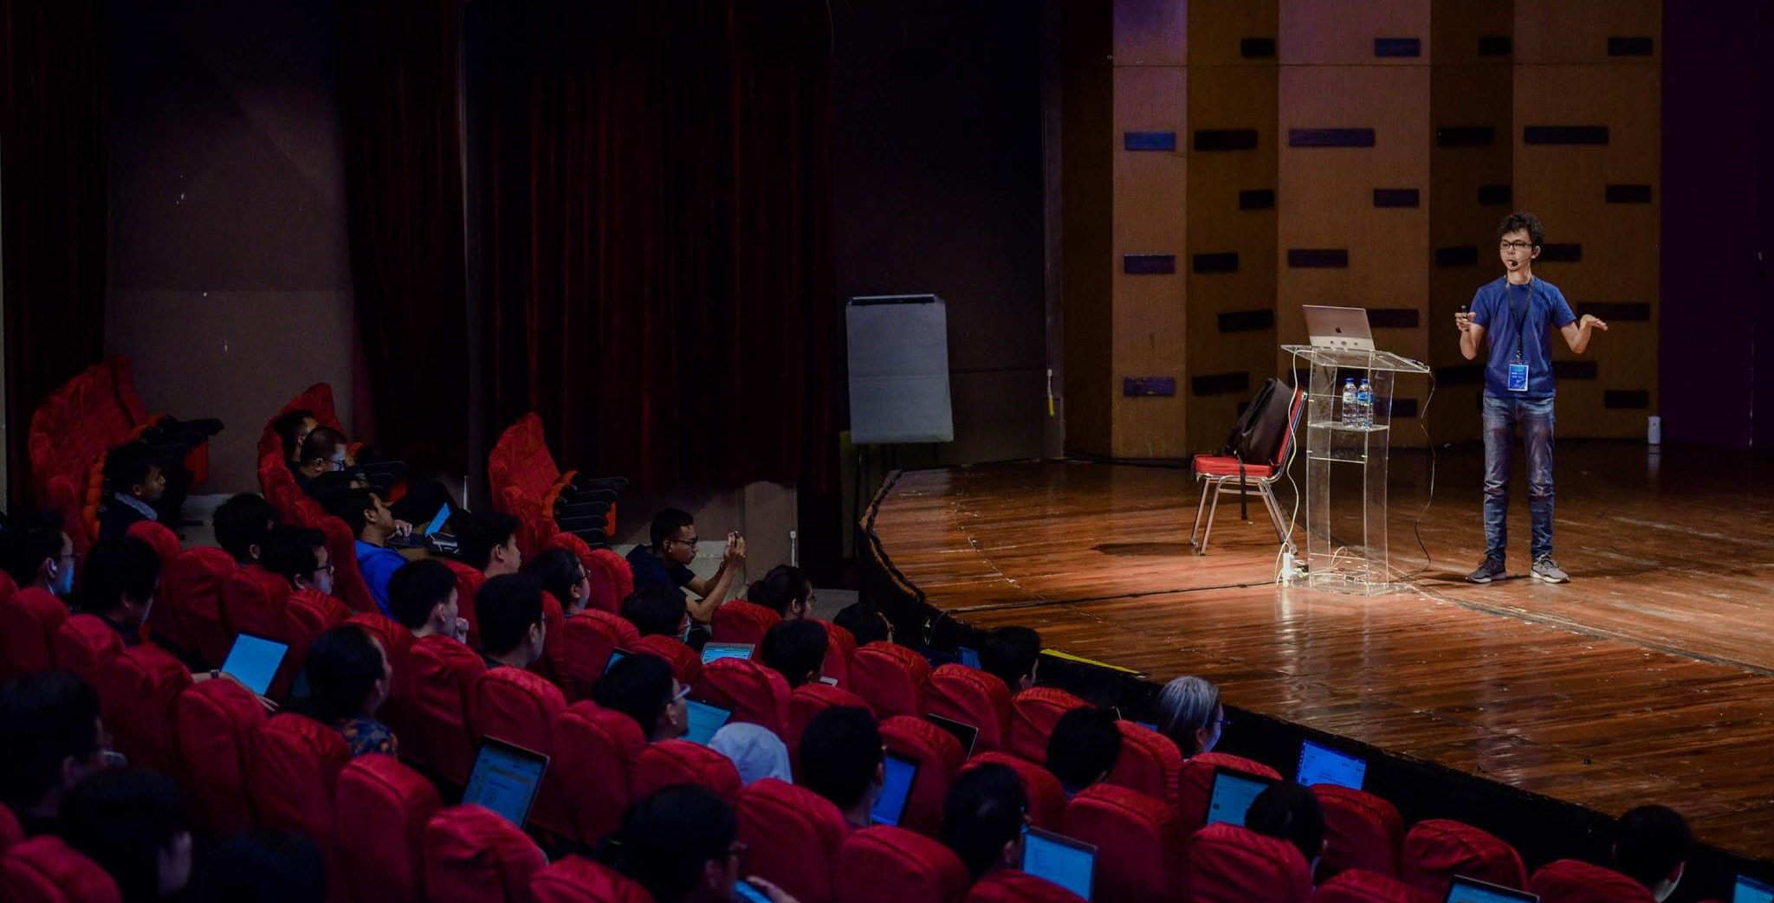
Eko Kurniawan Khannedy
Technical architect at one of the biggest ecommerce company in Indonesia
12+ years experiences
www.programmerzamannow.com
youtube.com/c/ProgrammerZamanNow

Slide 3
Eko Kurniawan Khannedy
Telegram : @khannedy
Linkedin : https://www.linkedin.com/company/programmer-zaman-now/
Facebook : fb.com/ProgrammerZamanNow
Instagram : instagram.com/programmerzamannow
Youtube : youtube.com/c/ProgrammerZamanNow
Telegram Channel : t.me/ProgrammerZamanNow
Tiktok : https://tiktok.com/@programmerzamannow
Email : echo.khannedy@gmail.com

Slide 4
Sebelum Belajar
Kelas PHP dari Programmer Zaman Now
Kelas MySQL dari Programmer Zaman Now
Kelas OpenAPI dari Programmer Zaman Now
Laravel Dasar
Laravel Eloquent
Laravel Eloquent API Resource

Slide 5
Requirement

Slide 6
Requirement
Pada kelas ini, kita akan coba membuat RESTful API untuk Contact Management, dimana RESTful API yang akan kita buat memiliki fitur sebagai berikut :
User Management
Contact Management
Address Management

Slide 7
User Management Requirement

Slide 8
User Data
Username
Password
Name
Token (Session Login)

Slide 9
User API
Register User
Login User
Update User
Get User
Logout User

Slide 10
Contact Management Requirement

Slide 11
Contact Data
First Name
Last Name
Email
Phone

Slide 12
Contact API
Create Contact
Update Contact
Get Contact
Search Contact
Remove Contact

Slide 13
Address Management Requirement

Slide 14
Contact Address Data
Street
City
Province
Country
Postal Code

Slide 15
Address API
Create Address
Update Address
Get Address
List Address
Remove Address

Slide 16
Membuat Project

Slide 17
Membuat Project
composer create-project laravel/laravel=v10.2.5 belajar-laravel-restful-api

Slide 18
User API Spec

Slide 19
Contact API Spec

Slide 20
Address API Spec

Slide 21
Setup Database

Slide 22
Setup Database
Buat database belajar_laravel_restful_api
Konfigurasi di project Laravel

Slide 23
User Model

Slide 24
Contact Model

Slide 25
Address Model

Slide 26
Register User API

Slide 27
Login User API

Slide 28
Get User API

Slide 29
Update User API

Slide 30
Logout User API

Slide 31
Create Contact API

Slide 32
Get Contact API

Slide 33
Update Contact API

Slide 34
Remove Contact API

Slide 35
Search Contact API

Slide 36
Create Address API

Slide 37
Get Address API

Slide 38
Update Address API

Slide 39
Remove Address API

Slide 40
List Address API

Slide 41
Manual Test

Slide 42
Materi Selanjutnya

Slide 43
Materi Selanjutnya
Belajar Fitur Laravel lainnya
Perbanyak studi kasus

